Slide 1
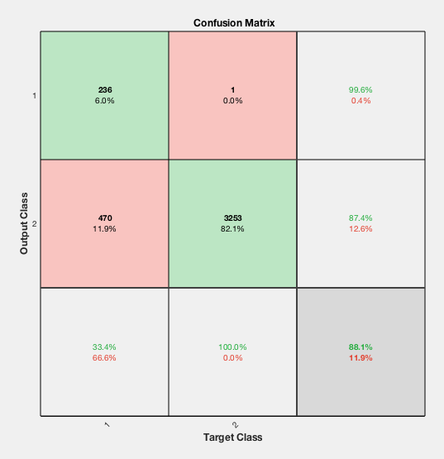
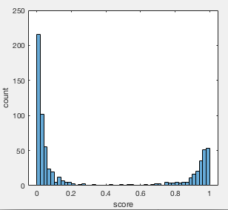
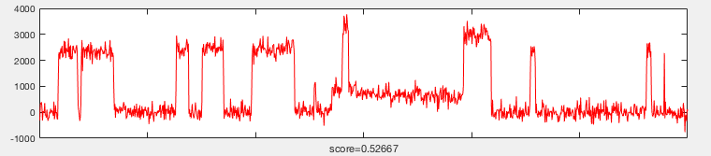
SiMREPS machine learning preliminary results
The objective of learning is to classify all WT traces as background while classify as many MUT traces as good traces as possible.
The training results show that our objective is achieved: Almost all WT experiment traces are classified as background.
The only one misclassified WT trace is shown here. The score = 0.53 is close to classification boundary 0.5.
Some of the MUT traces are shown in the next slides, ordered by descending scores.
The score distribution for MUT traces is also shown here.
Good trace
Background
MUT
WT
(Exp. condition)
Classification results after training

Slide 2
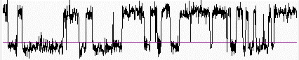
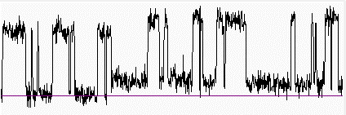
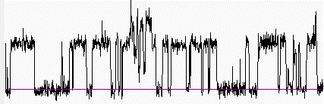
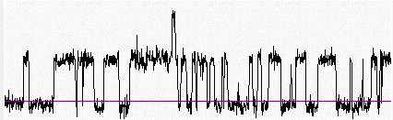
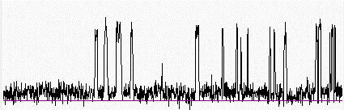
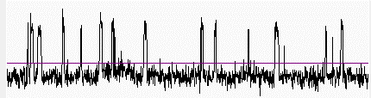
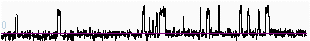
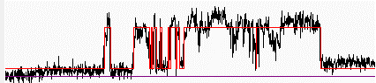
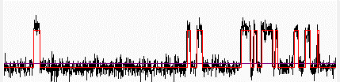
Accepted traces in 50 nM WT data from HMM analysis
n2, trace 394
May be true positives
(e.g. contaminants),
but bound-state dwell time perhaps looks longer than most traces in MUT datasets
n3, trace 261
n3, trace 293
n3, trace 355
n5, trace 87
Probably false positives
n6, trace 207
n6, trace 210
n7, trace 87
n7, trace 441

Slide 3
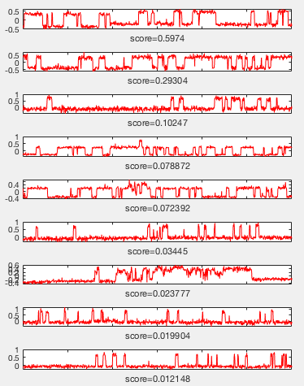
ML assigned scores for accepted traces

Slide 4
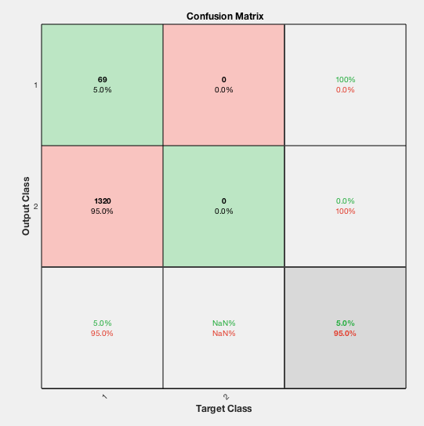
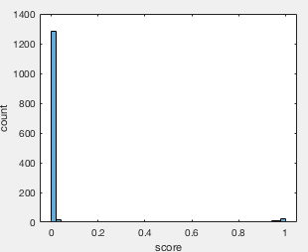
ML analysis of 1 to 1 mil data (3 movies)
Good trace
Background
1 to 1 mil
N/A
(Exp. condition)

Slide 5
Selected traces and some background traces (69 selected traces in total)

Slide 6
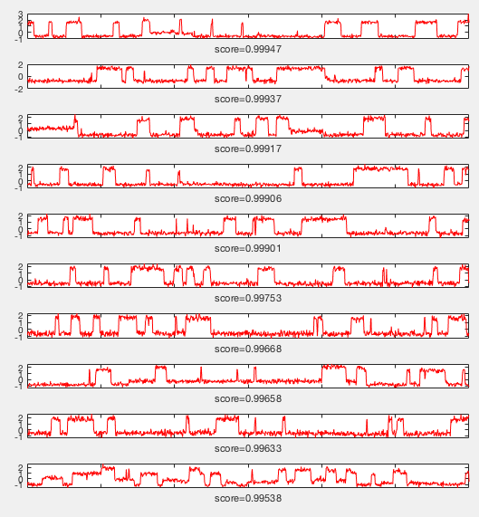

Slide 7
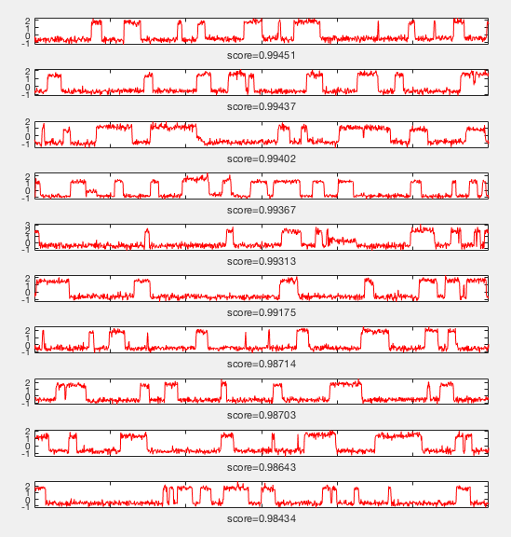

Slide 8
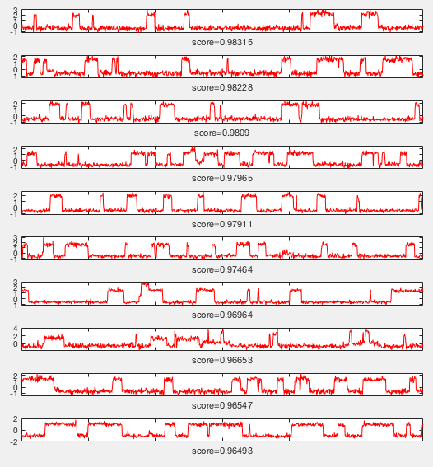

Slide 9
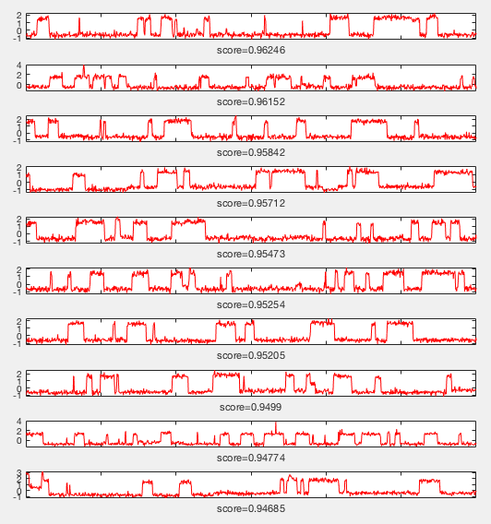

Slide 10
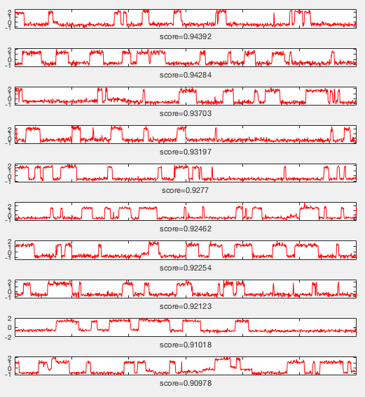

Slide 11
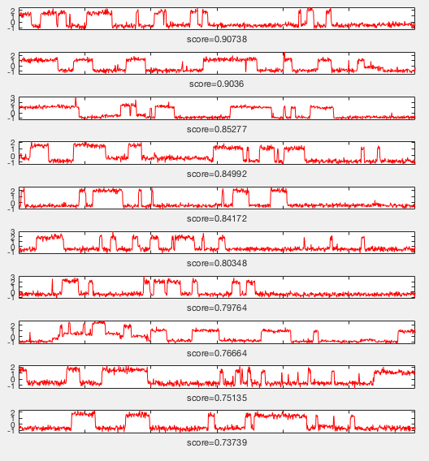

Slide 12
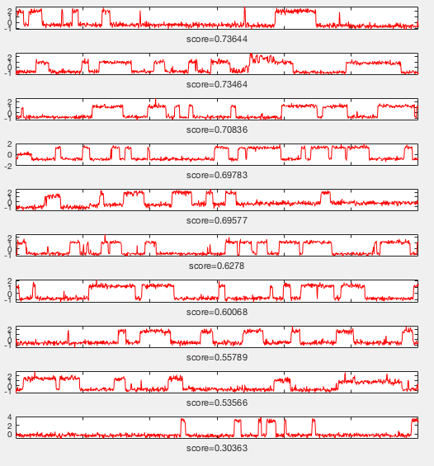

Slide 13
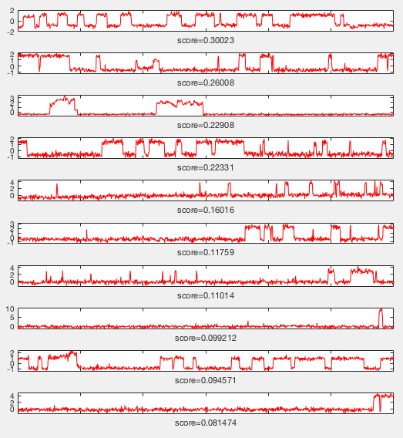

Slide 14
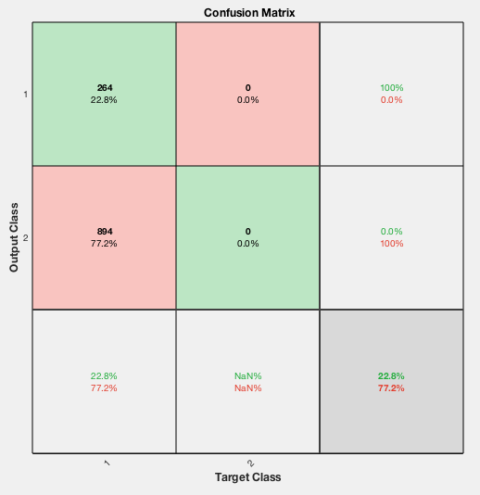
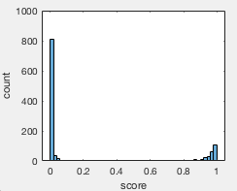
ML analysis of 1 to 10k data (4 movies)
Good trace
Background
1 to 10k
N/A
(Exp. condition)

Slide 15
Selected traces and some background traces (264 selected traces in total)

Slide 16
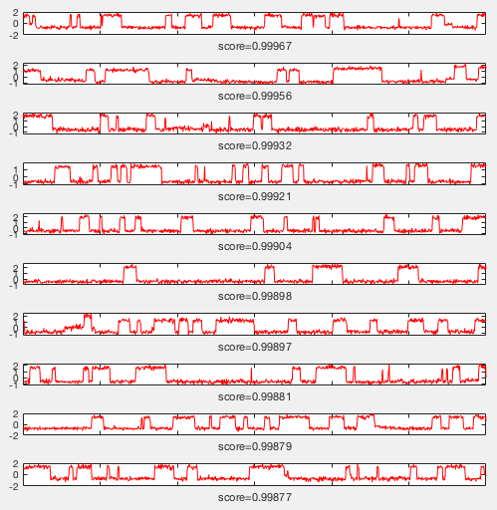
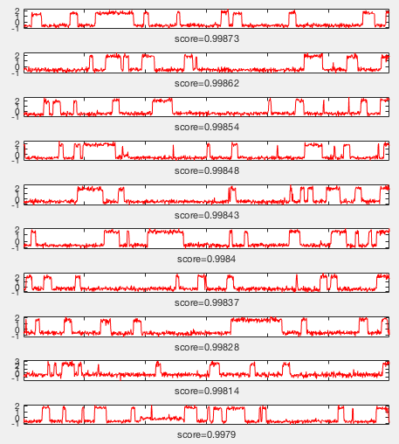

Slide 17
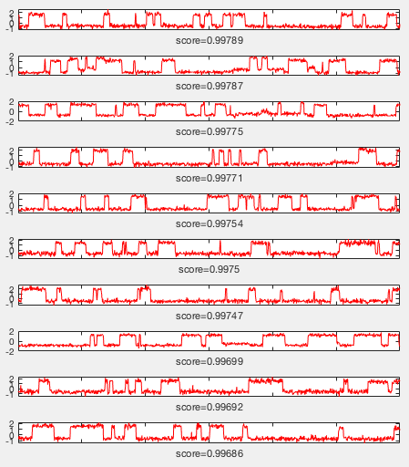
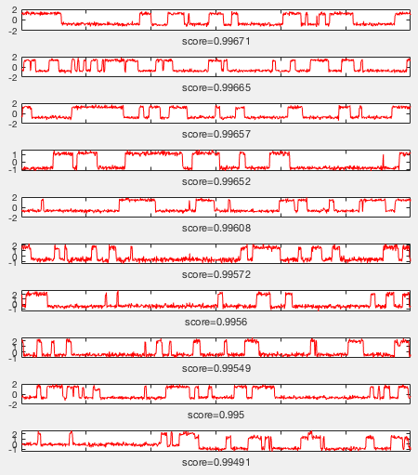

Slide 18
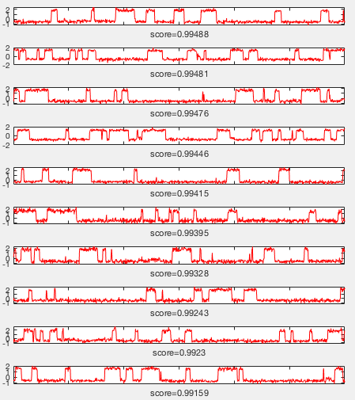
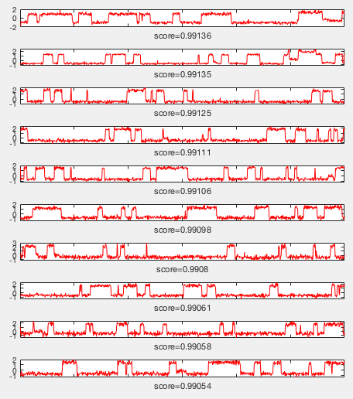

Slide 19
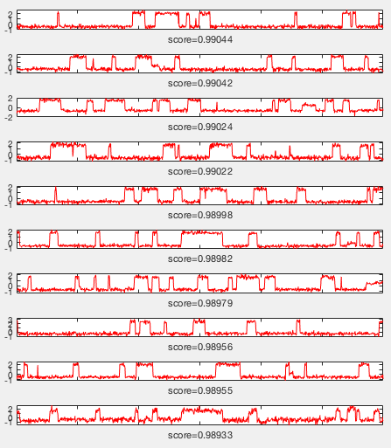
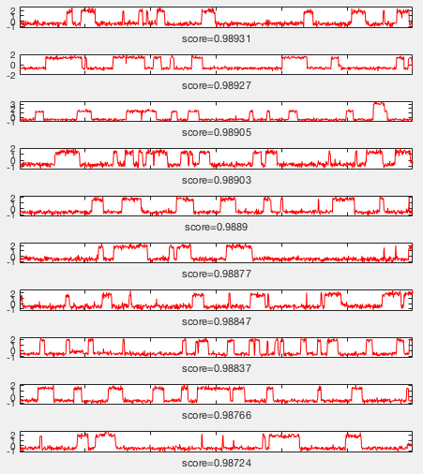

Slide 20
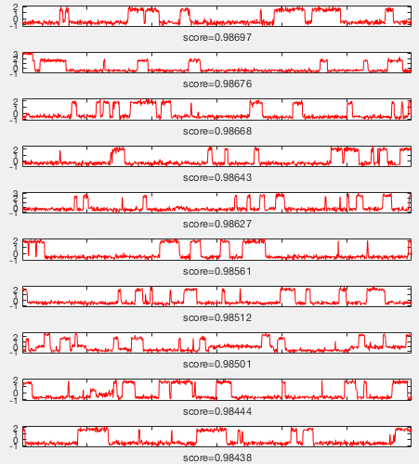
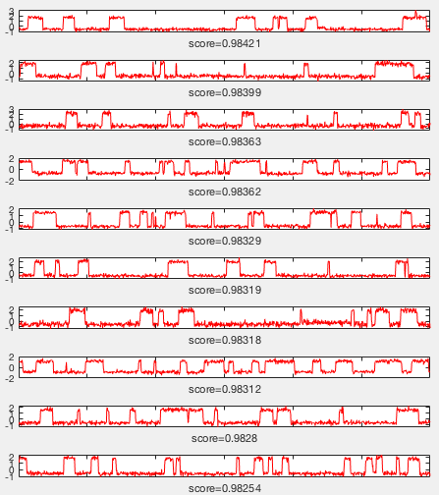

Slide 21
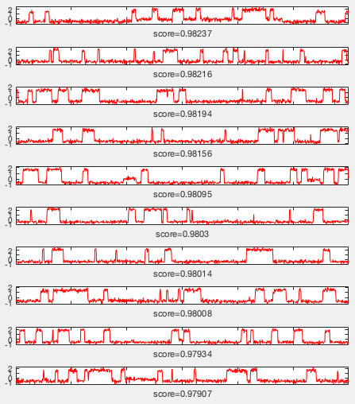
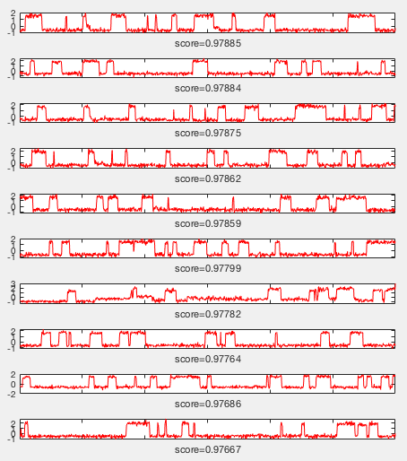

Slide 22
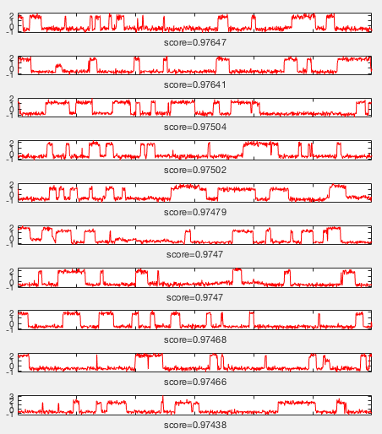
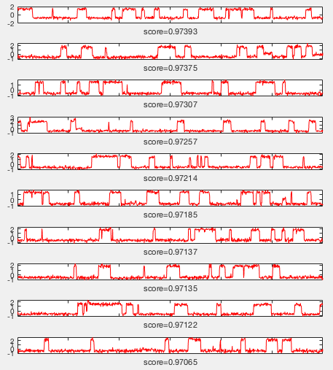

Slide 23
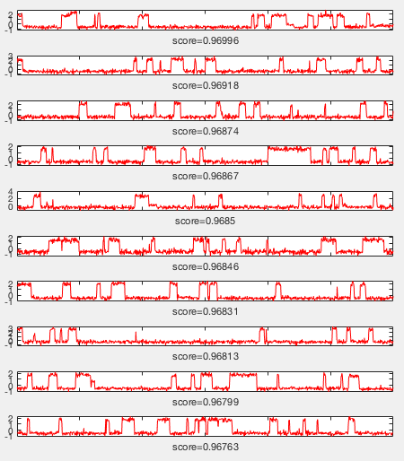
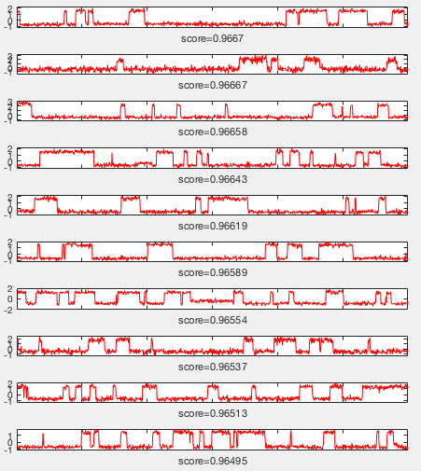

Slide 24
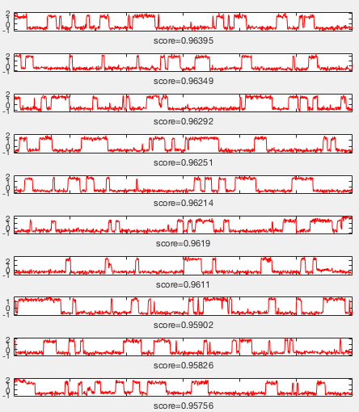
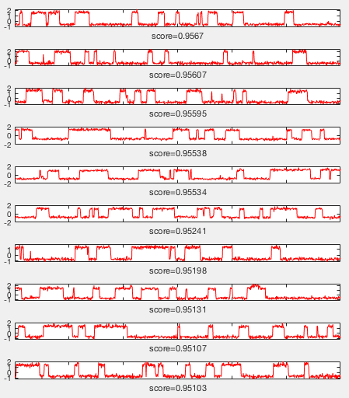

Slide 25
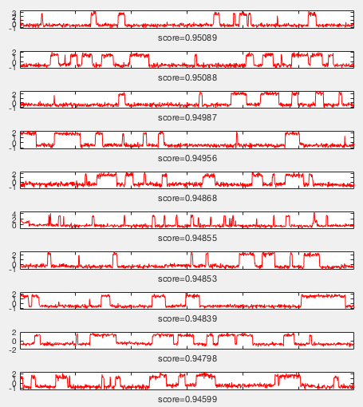
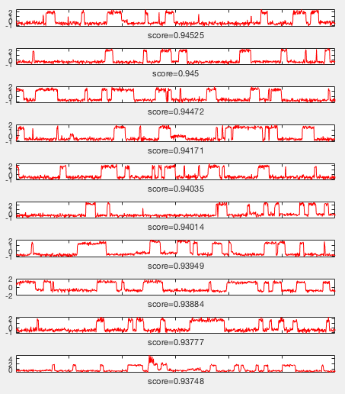

Slide 26
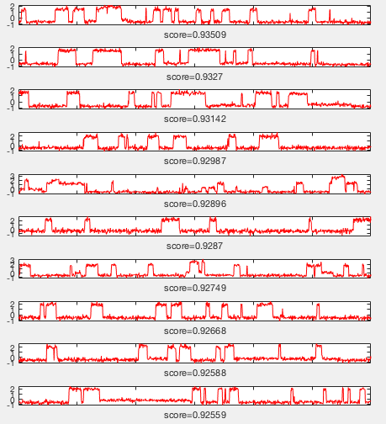
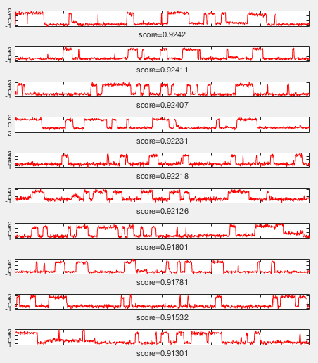

Slide 27
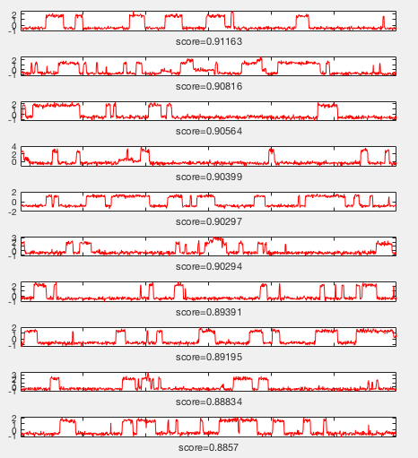
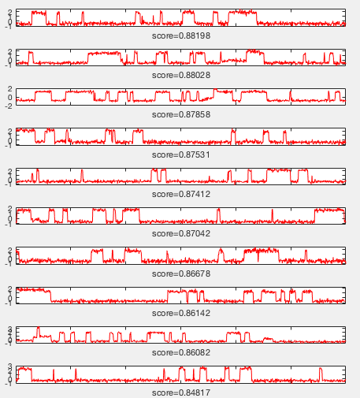

Slide 28
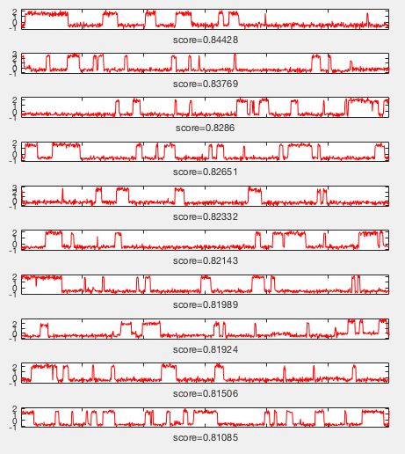


Slide 29



Slide 30



Slide 31



Slide 32


ML analysis of 1 to 100k data (3 movies)
Good trace
Background
1 to 100k
N/A
(Exp. condition)

Slide 33
Selected traces and some background traces (147 selected traces in total)

Slide 34



Slide 35



Slide 36



Slide 37



Slide 38



Slide 39



Slide 40



Slide 41



Slide 42



Slide 43



Slide 44



Slide 45


ML analysis of NDC data (2 movies)
Good trace
Background
NDC
N/A
(Exp. condition)

Slide 46
Some background traces

Slide 47



Slide 48



Slide 49



Slide 50



Slide 51



Slide 52
Positive traces selected by ML algorithm from MUT 3 movies

Slide 53


Slide 54


Slide 55


Slide 56



Slide 57



Slide 58


Slide 59


Slide 60


Slide 61


Slide 62


Slide 63


Slide 64


Slide 65


Slide 66


Slide 67


Slide 68


Slide 69


Slide 70


Slide 71


Slide 72


Slide 73


Slide 74


Slide 75


Slide 76


Slide 77


Slide 78


Slide 79


Slide 80


